Slide 1
Clustering
Hierarchical clustering
* Agglomerative clustering – bottom up approach
* divise clustering- top down approach
PCA
K-Means

Slide 2
UNSUPERVISED LEARNING:
Unsupervised Learning is a machine learning technique in which the users do not need to supervise the model. Instead, it allows the model to work on its own to discover patterns and information that was previously undetected. It mainly deals with the unlabelled data.
Datasets are not labelled and are sorted according to similarities or differences

Slide 3
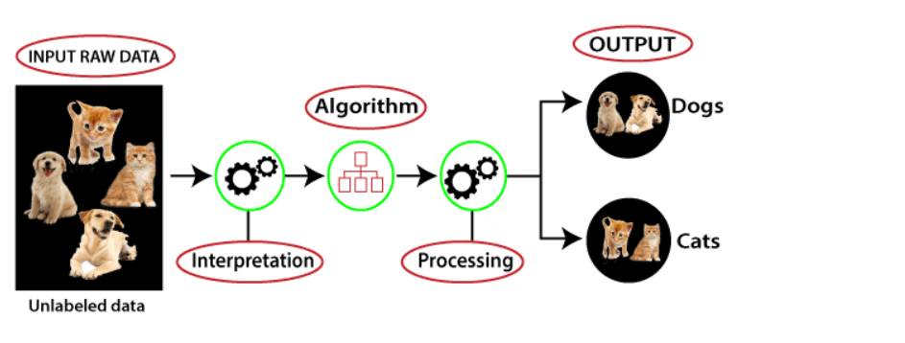
Unsupervised learning working:

Slide 4
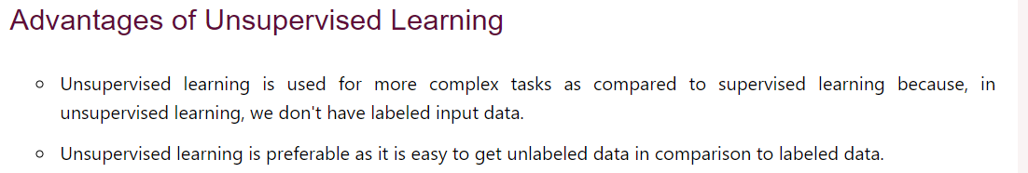

Slide 5
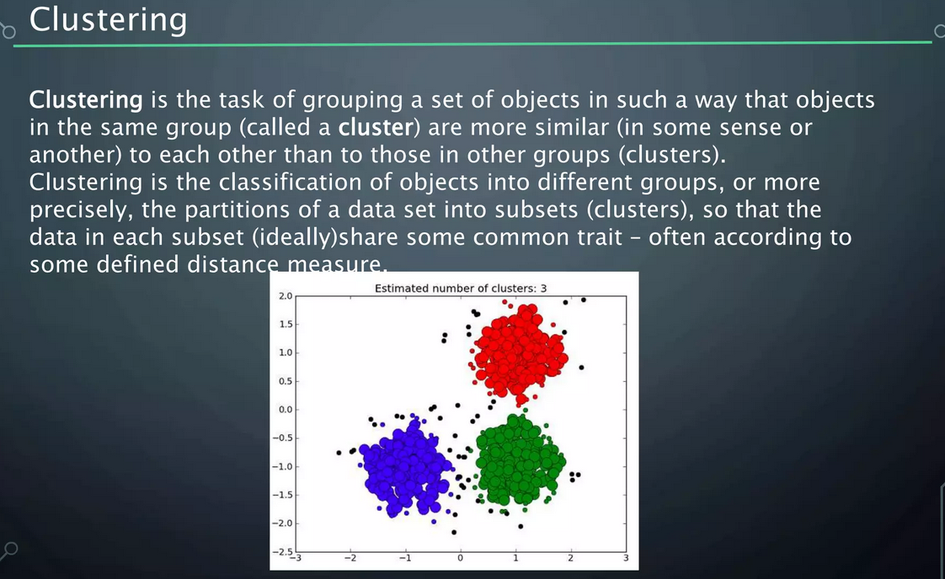

Slide 6
For which datasets we can use k-means, Hierarchical clustering , PCA
Hierarchical clustering - Hierarchical clustering is particularly useful in situations where you have a few observations you are particularly interested in and you want to be able to identify observations that are similar to those observations.
not useful for vast amount of data
PCA – when there is huge dimensional values this helps to converge them into smaller dimentional values
K-means -a type of unsupervised learning, which is used when you have unlabeled data

Slide 7
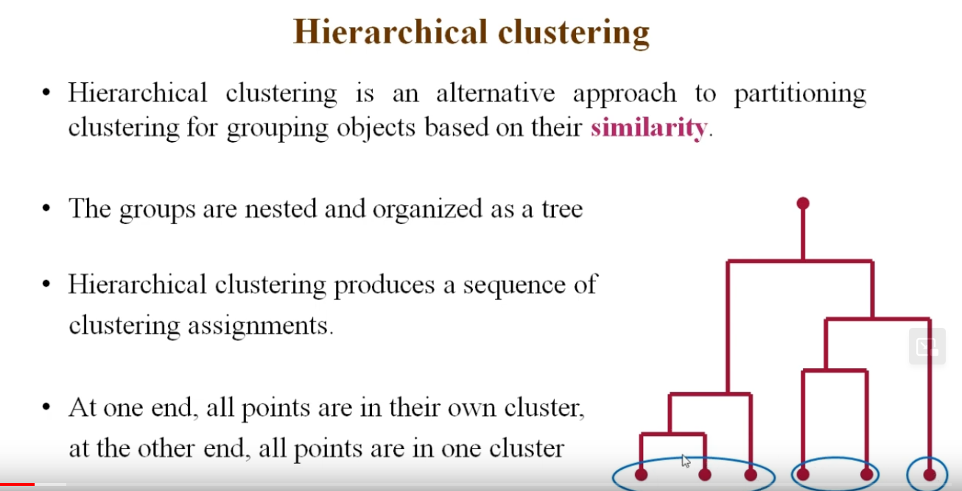

Slide 8
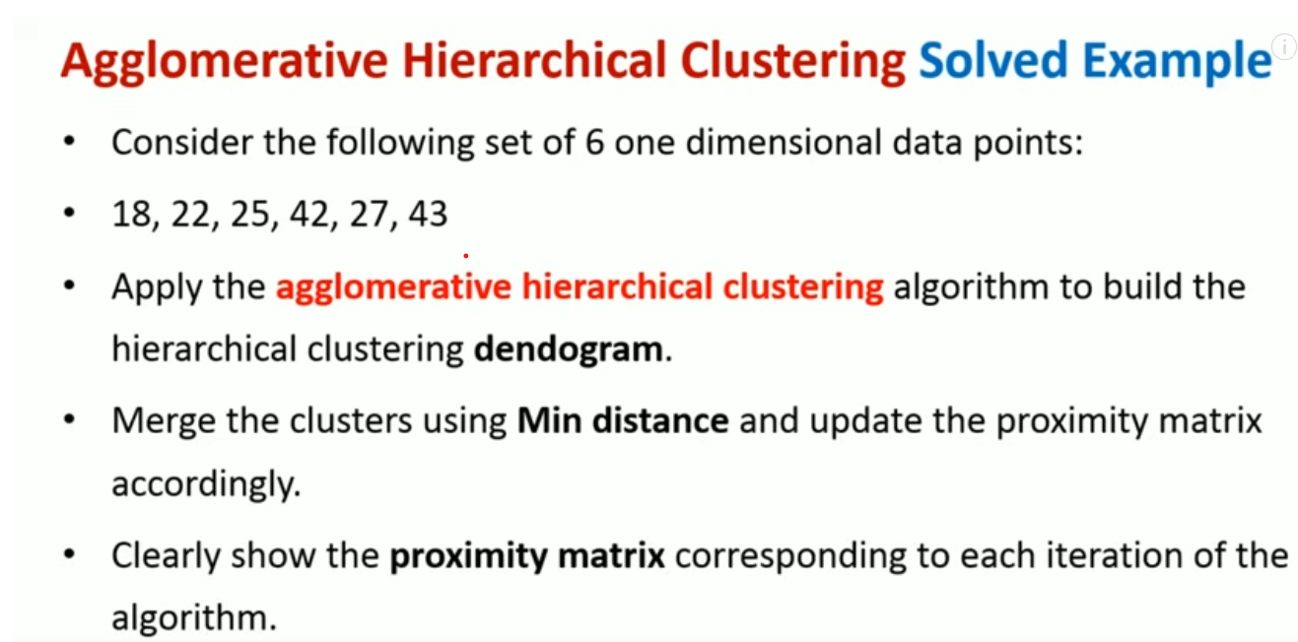

Slide 10
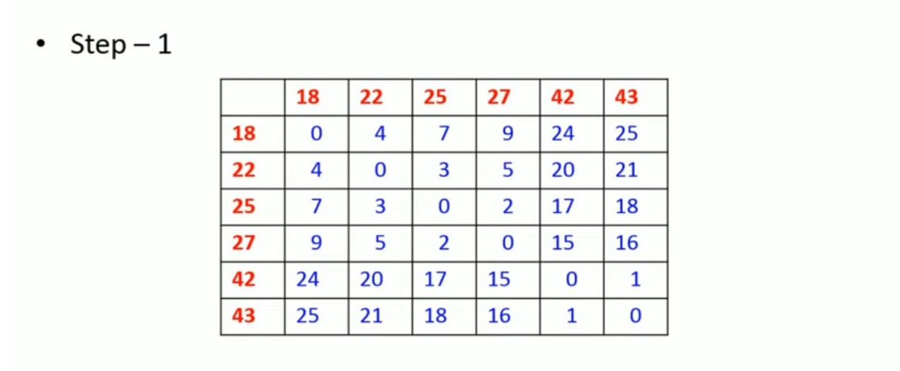

Slide 11
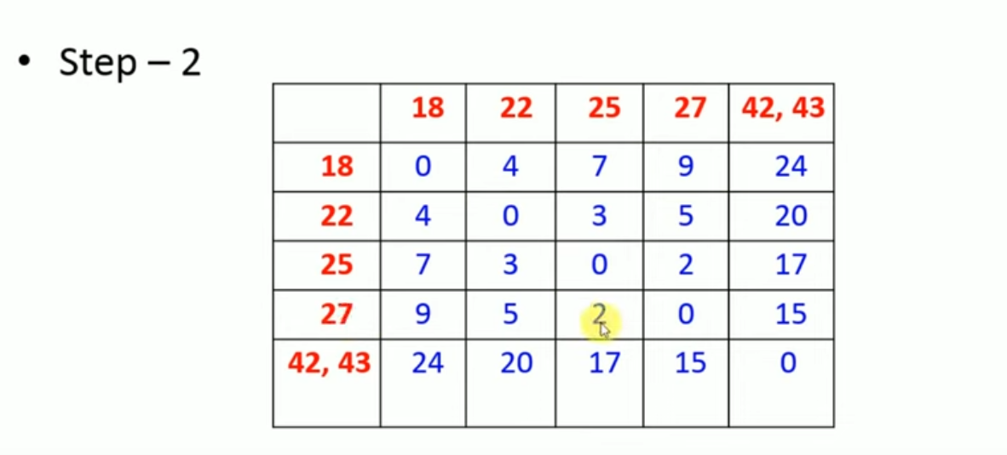

Slide 12
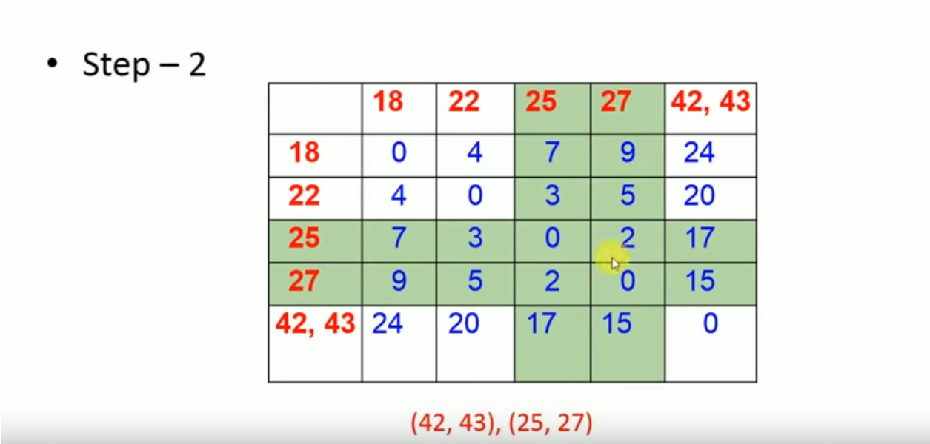

Slide 14
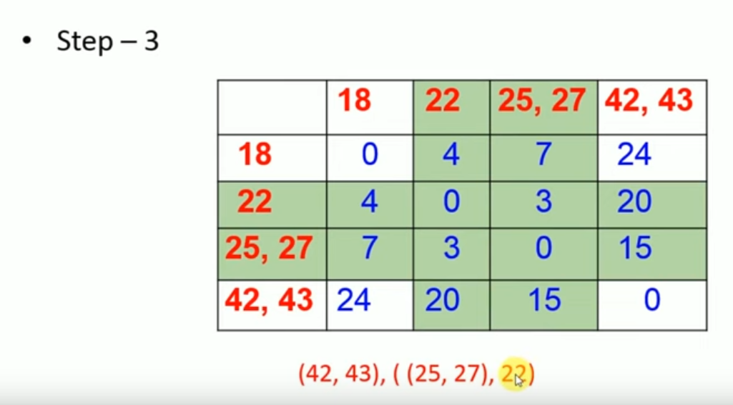

Slide 16
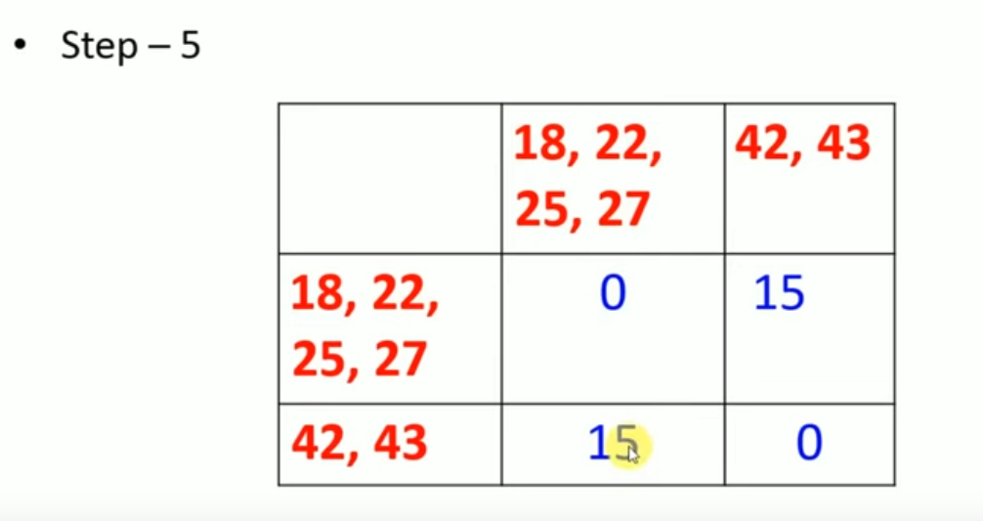

Slide 17
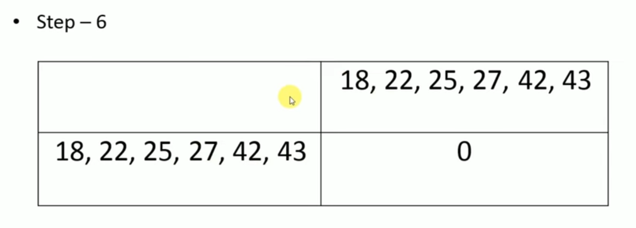

Slide 18
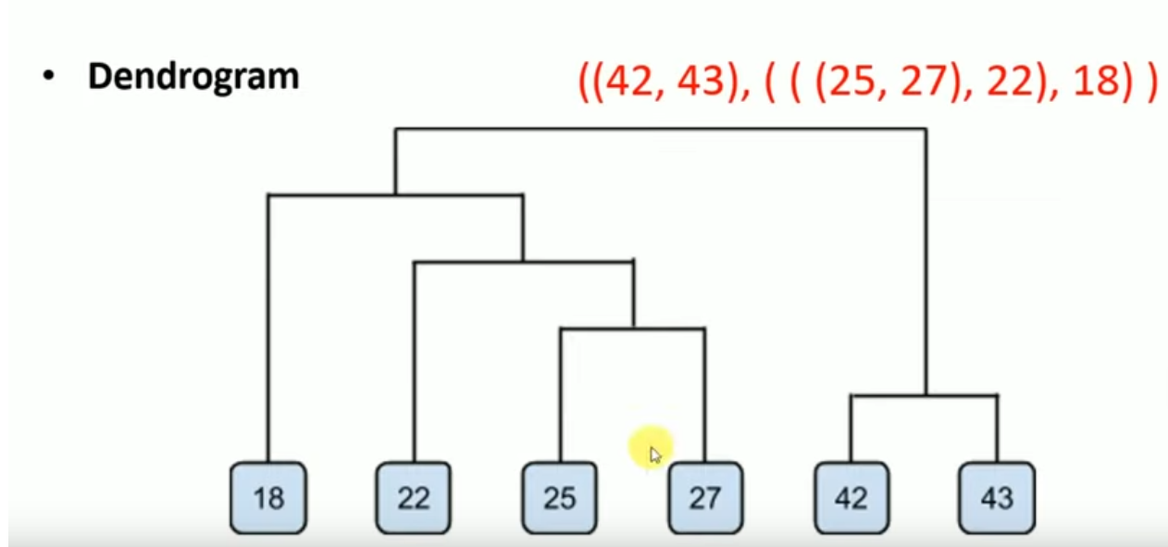

Slide 19
PCA- PRINCIPLE COMPONENT ANALYSIS

Slide 20
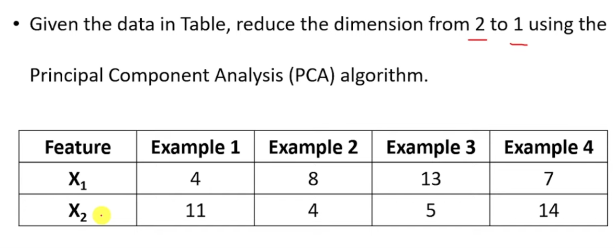
LET’S SEE AN EXAMPLE,

Slide 22
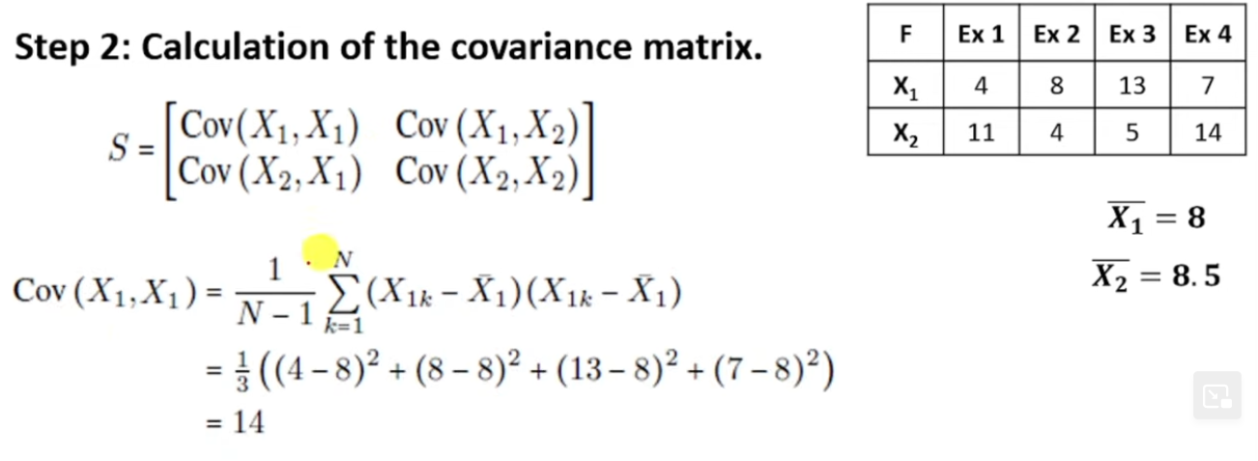

Slide 25
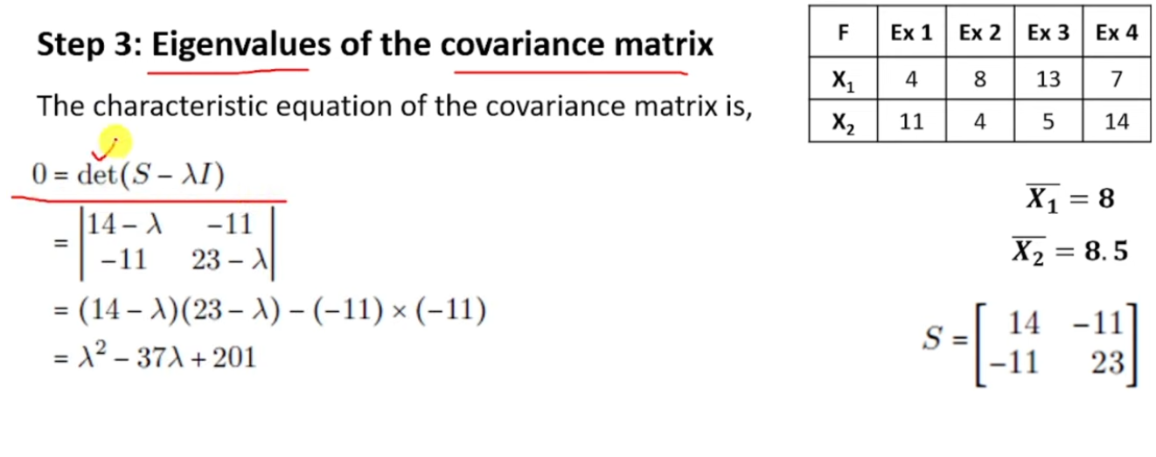

Slide 27
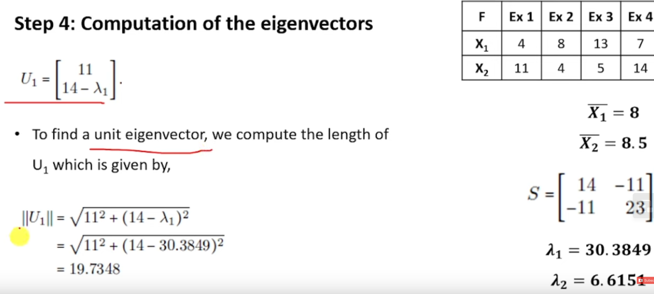

Slide 29
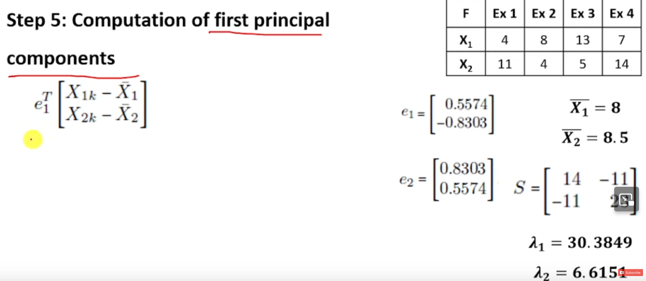

Slide 30
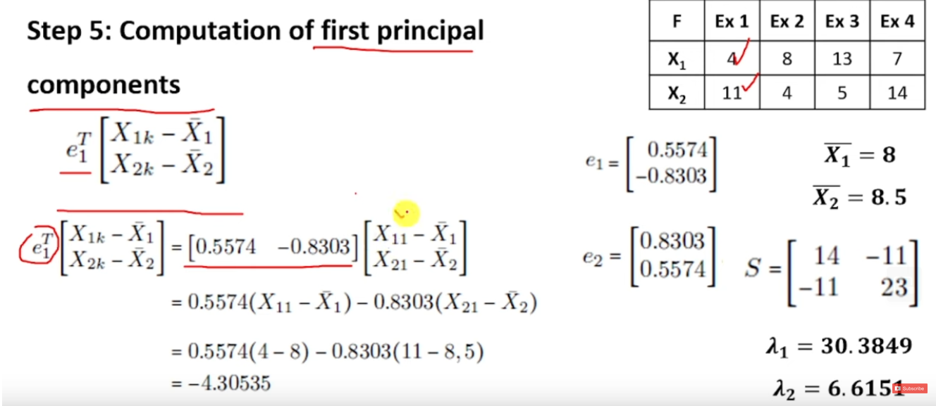

Slide 31
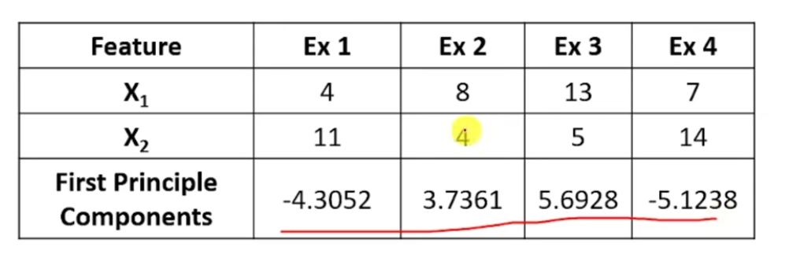

Slide 32
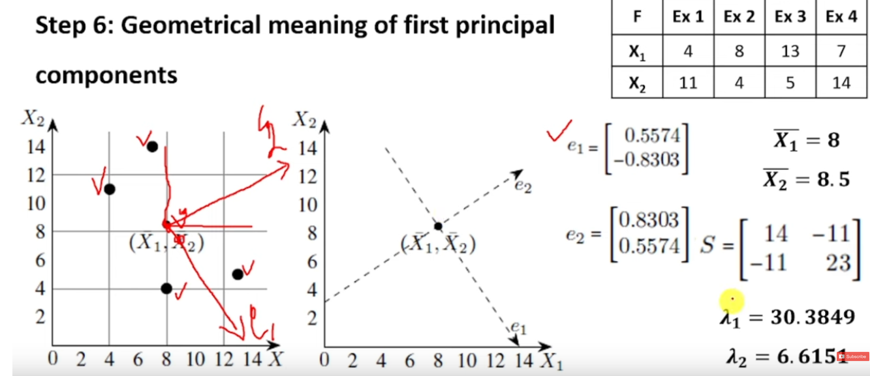

Slide 33
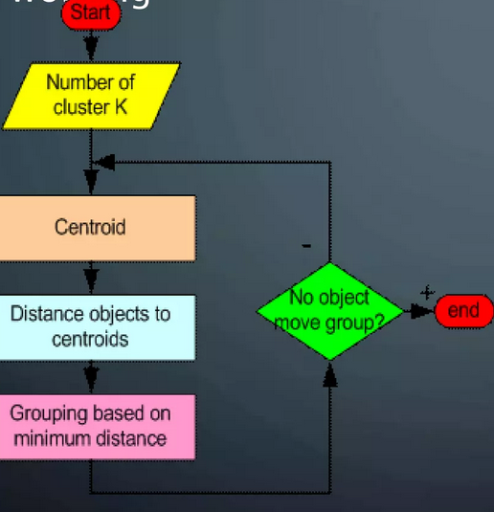
KMEANS ALGORITHM

Slide 34
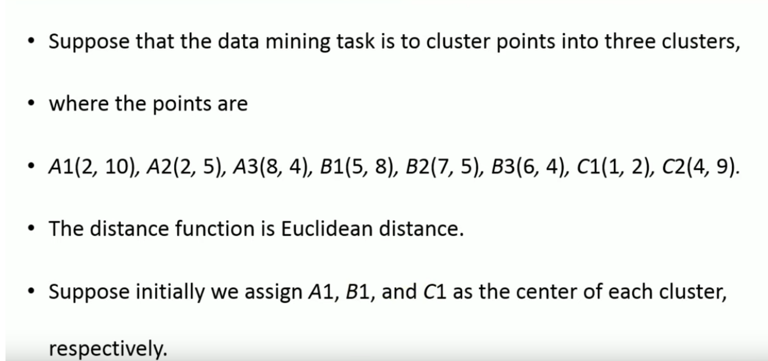

Slide 36
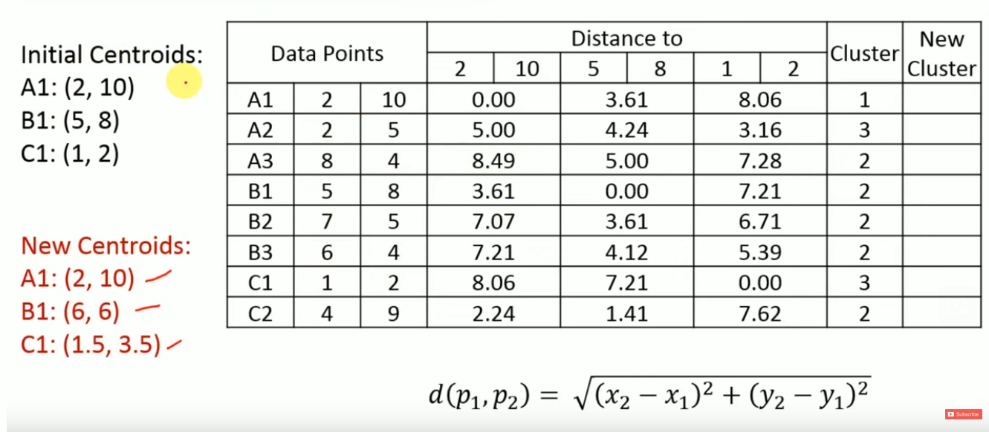

Slide 37
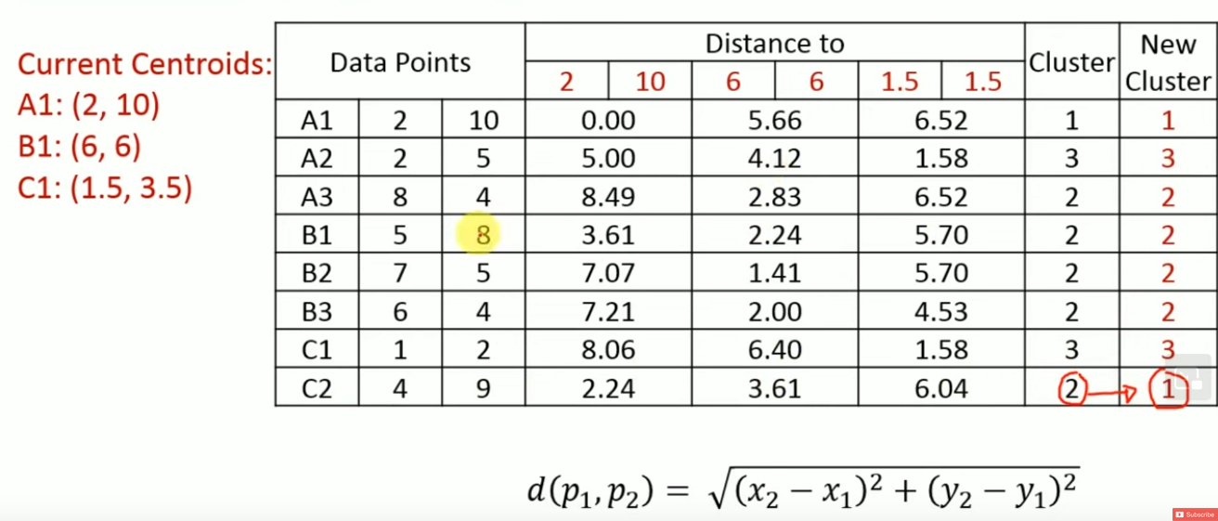

Slide 38
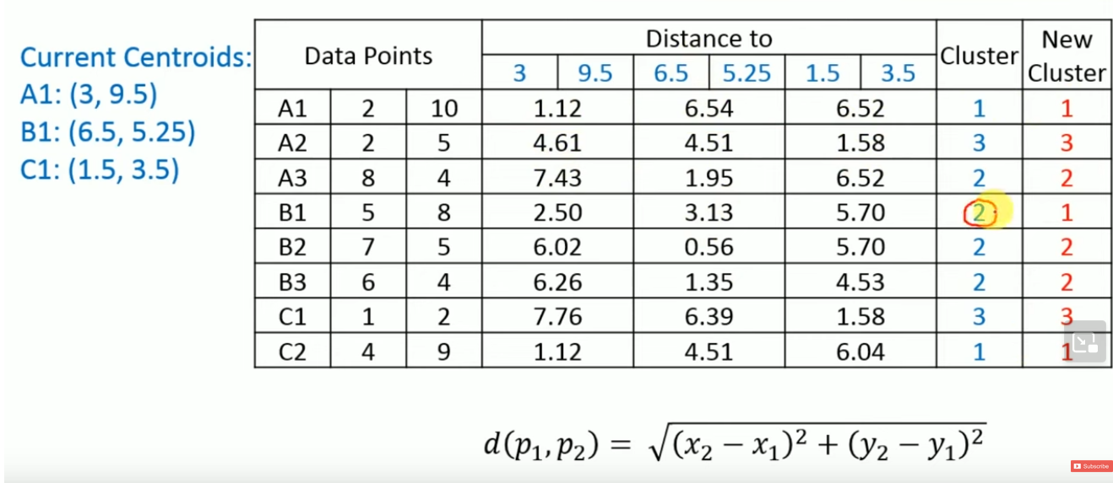

Slide 39
